Slide 1
Cornerstone City Church Peninsula Plus Community Hoo Are Ya 02-07-2023

Slide 2
Great Big God
CCLI Song # 3373437
Jo Hemming | Nigel Hemming
© 2001 Vineyard Songs (UK/Eire) (Admin. by Integrity Music Ltd)
For use solely with the SongSelect® Terms of Use. All rights reserved. www.ccli.com
CCLI Licence No. 33265

Slide 3
1/2
Our God is a great big God
Our God is a great big God
Our God is a great big God
And He holds us in His hands

Slide 4
2/2
He's higher than a skyscraper
And He's deeper than a submarine
He's wider than the universe
And beyond my wildest dreams
And He's known me and He's loved me
Since before the world began
How wonderful to be a part of
God's amazing plan

Slide 5
You Are Good
CCLI Song # 3383788
Israel Houghton
© 2001 Integrity's Praise! Music (Admin. by Integrity Music)
Sound Of The New Breed (Admin. by Integrity Music)
For use solely with the SongSelect® Terms of Use. All rights reserved. www.ccli.com
CCLI Licence No. 33265

Slide 6
1/3
Lord You are good And Your mercy endureth forever Lord You are good And Your mercy endureth forever People from every nation and tongue From generation to generation

Slide 7
2/3
We worship You Hallelujah hallelujah We worship You for who You are We worship You Hallelujah hallelujah We worship You for who You are For You are good

Slide 8
3/3
You are good all the time All the time You are good You are good all the time All the time You are good

Slide 9
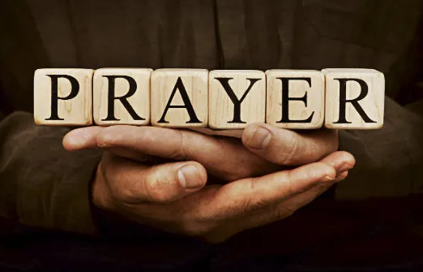

Slide 10
Your Name
CCLI Song # 4611679
Glenn Packiam | Paul Baloche
© 2006 Integrity Worship Music (Admin. by Integrity Music Ltd)
Integrity's Hosanna! Music (Admin. by Integrity Music Ltd)
For use solely with the SongSelect® Terms of Use. All rights reserved. www.ccli.com
CCLI Licence No. 33265

Slide 11
1/4
As morning dawns and evening fades
You inspire songs of praise
That rise from earth to touch Your heart
And glorify Your Name

Slide 12
2/4
Your Name is a strong and mighty tower
Your Name is a shelter like no other
Your Name let the nations sing it louder
'Cause nothing has the power to save
But Your Name

Slide 13
3/4
Jesus in Your Name we pray
Come and fill our hearts today
Lord give us strength to live for You
And glorify Your Name

Slide 14
4/4
Your Name is a strong and mighty tower
Your Name is a shelter like no other
Your Name let the nations sing it louder
'Cause nothing has the power to save
But Your Name

Slide 16
Worthy
CCLI Song # 7111931
Chris Brown | Mack Brock | Steven Furtick
© Music by Elevation Worship Publishing (Admin. by Essential Music Publishing LLC)
For use solely with the SongSelect® Terms of Use. All rights reserved. www.ccli.com
CCLI Licence No. 33265

Slide 17
1/4
It was my cross You bore
So I could live in the freedom You died for
And now my life is Yours
And I will sing of Your goodness forevermore

Slide 18
2/4
Worthy is Your name, Jesus
You deserve the praise
Worthy is Your name
Worthy is Your name, Jesus
You deserve the praise
Worthy is Your name

Slide 19
3/4
And now my shame is gone
I stand amazed in Your love undeniable
Your grace goes on and on
And I will sing of Your goodness forevermore

Slide 20
4/4
Be exalted now in the heavens
As Your glory fills this place
You alone deserve our praise
You're the name above all names

Slide 22
I Speak Jesus
CCLI Song # 7136201
Abby Benton | Carlene Prince | Dustin Smith | Jesse Reeves | Kristen Dutton | Raina Pratt
© 2019 Here Be Lions Publishing (Admin. by Integrity Music Ltd)
Integrity's Praise! Music (Admin. by Integrity Music Ltd)
BEC Worship (Admin. by Song Solutions)
Raina Pratt publishing designee (Admin. by Song Solutions www.songsolutions.org)
WriterWrong Music (Admin. by Song Solutions www.songsolutions.org)
Remaining portion is unaffiliated
For use solely with the SongSelect® Terms of Use. All rights reserved. www.ccli.com
CCLI Licence No. 33265

Slide 23
1/5
I just want to speak the Name of Jesus
Over ev'ry heart and ev'ry mind
'Cause I know there is peace within Your presence
I speak Jesus

Slide 24
2/5
I just want to speak the Name of Jesus
'Til ev'ry dark addiction starts to break
Declaring there is hope and there is freedom
I speak Jesus

Slide 25
3/5
('Cause) Your Name is power
Your Name is healing
Your Name is life
Break ev'ry stronghold
Shine through the shadows
Burn like a fire

Slide 26
4/5
I just want to speak the Name of Jesus
Over fear and all anxiety
To ev'ry soul held captive by depression
I speak Jesus

Slide 27
5/5
Shout Jesus from the mountains
Jesus in the streets
Jesus in the darkness over ev'ry enemy
Jesus for my fam'ly
I speak the holy Name Jesus

Slide 28


Slide 29
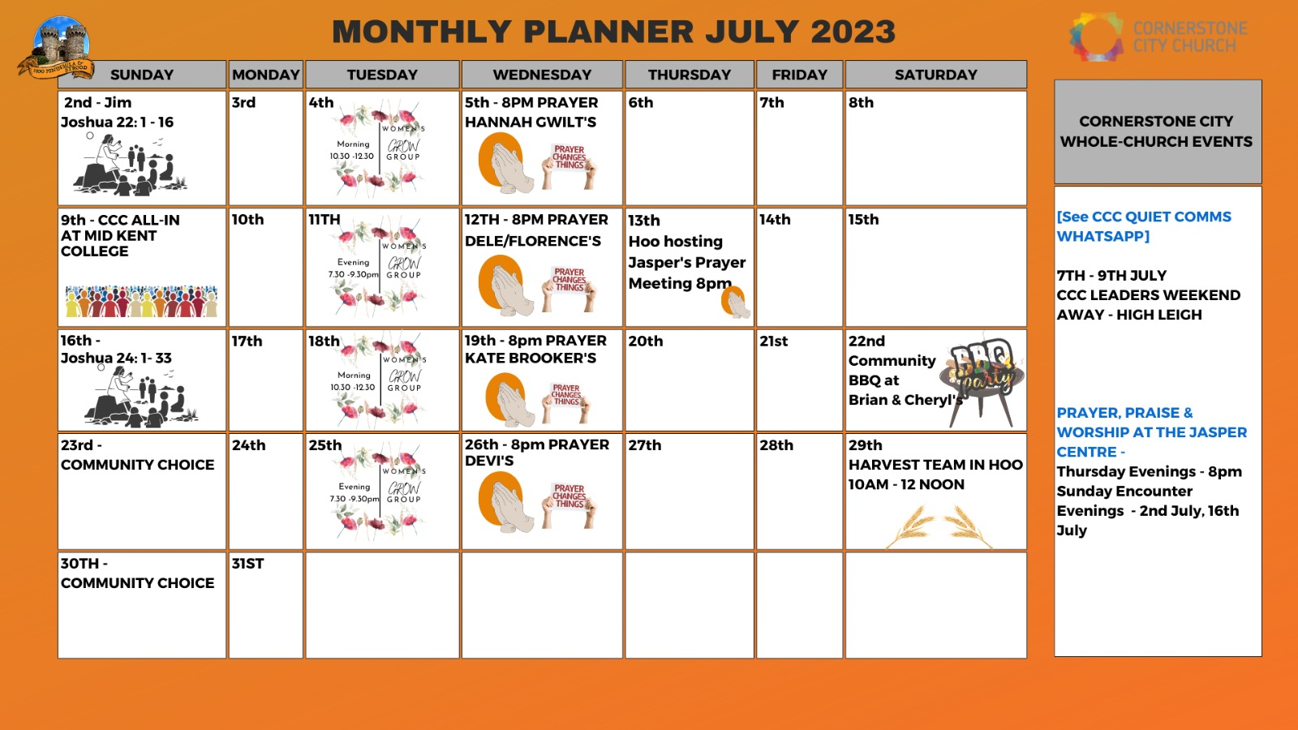

Slide 30


Slide 31
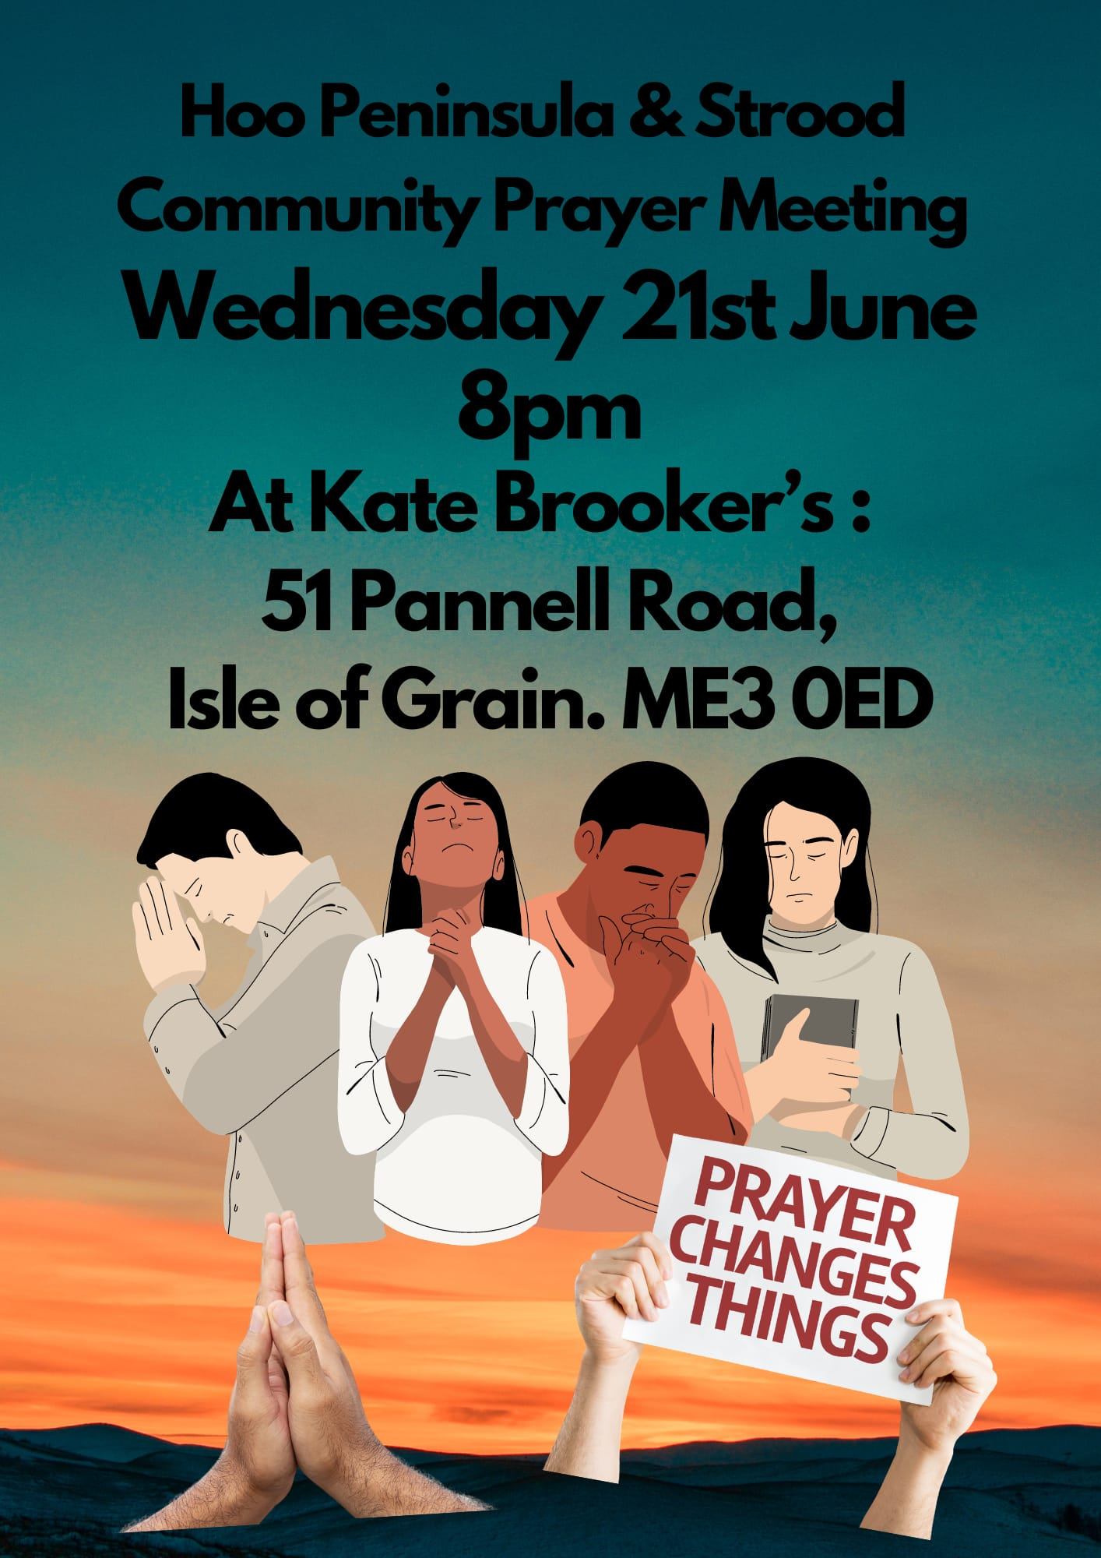

Slide 32


Slide 33
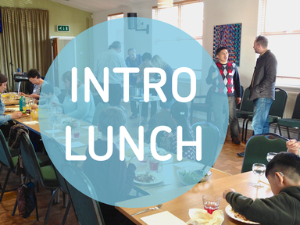

Slide 34


Slide 35


Slide 36


